Slide 1
Vedra: Eco Lifestyle Agent
IBM AICTE PROJECT
Presented By:
Student name: Suryank Malik
College Name- ABES Engineering College
Department- Computer Science

Slide 2
OUTLINE
Problem Statement
Proposed System/Solution
System Development Approach
Algorithm
Deployment
Result (Output Image)
Conclusion
Future Scope
References

Slide 3
Problem Statement
The Eco Lifestyle Agent, built with Watsonx Assistant, helps people live more eco-friendly by providing simple, personalized tips. It answers questions like "How can I use less plastic?" or "What green travel options are near me?" It also shares advice on sustainable habits, products, recycling, and government programs. This tool makes going green easy and practical for everyday life.

Slide 4
Proposed Solution
Mood-Aware Eco Suggestions
Using sentiment detection, it changes responses based on your tone. If you seem stressed or tired, it says: “Take a walk in the park today. It’s good for you and the Earth".
A Game-Like Missions
Users receive fun daily missions to make eco-friendly choices. “Your Quest Today: Refuse two plastic bags.
Reward: This makes the journey interactive and engaging.
Build a Digital Clone of Your Lifestyle
The agent builds a virtual “EcoTwin” – a profile of your lifestyle footprint based on what you search and the
actions you take.
It visualizes: Your carbon footprint, Water saving score , Plastic-free days

Slide 5
System Approach
System requirements-
Hardware Requirements:
Device: Any device with a modern web browser, including a laptop, desktop, tablet, or mobile Internet
A stable internet connection
Software Requirements:
IBM Cloud account (Lite or Standard)
IBM Watsonx Assistant enabled

Slide 6
Tools used
Watsonx Assistant: the main conversational AI framework, focuses on intent handling, dialogue design, and user flow.
Prompt Templates: provide predefined responses and follow-up actions for FAQs.
Actions UI: a visual flow builder that allows you to design no-code or low-code conversational paths.
Web Chat Integration: lets you embed a chatbot in a website, mobile app, or portal.
Watsonx.ai: is an optional feature for future AI services such as RAG or sentiment-aware answers.
Cloud Object Storage: enables you to store PDFs, knowledge bases, or eco-related datasets if needed.
Assistant Analytics: helps you track user interactions, the most common queries, and user feedback.

Slide 7
Algorithm
Unlike traditional ML prediction systems, the Eco Lifestyle Agent uses rule-based conversational logic and intent recognition within Watsonx Assistant. This method was selected because the main goal is to provide real-time, actionable eco-suggestions based on user queries. It does not aim to predict future outcomes.
Watsonx Assistant employs intent classification, entity recognition, and dialogue flow management to understand user input and offer personalized guidance. For improved intelligence, it can optionally integrate retrieval-based systems like RAG (Retrieval-Augmented Generation)

Slide 8
End users
Environmentally conscious individuals
Students & young adults
Families & homemakers
Educational institutions

Slide 9
Deployment
The Eco Lifestyle Agent is set up through the following steps:
1. Build and Train Assistant
Create intents, entities, and actions in Watsonx Assistant.
Configure custom prompts and branching logic.
2. Test on Preview Interface
Use Watson’s preview panel to simulate conversations.
3. Deploy on Platform of Choice
Use Web Chat integration to embed the assistant in websites or mobile apps.
You can also integrate with WhatsApp, Slack, or MS Teams.
4. Monitor and Improve
Use Watson Assistant’s built-in analytics to monitor user engagement.
Regularly update eco content, adjust flows, and add new features like EcoTwin or Mood-aware nudges.

Slide 10
Result
The Eco Lifestyle Agent provides personalized, real-time eco-tips with Watsonx Assistant. It understands user questions naturally and encourages daily sustainability. It also offers local green suggestions. The assistant is responsive and easy to use, helping users make environmentally friendly choices with ease.

Slide 11
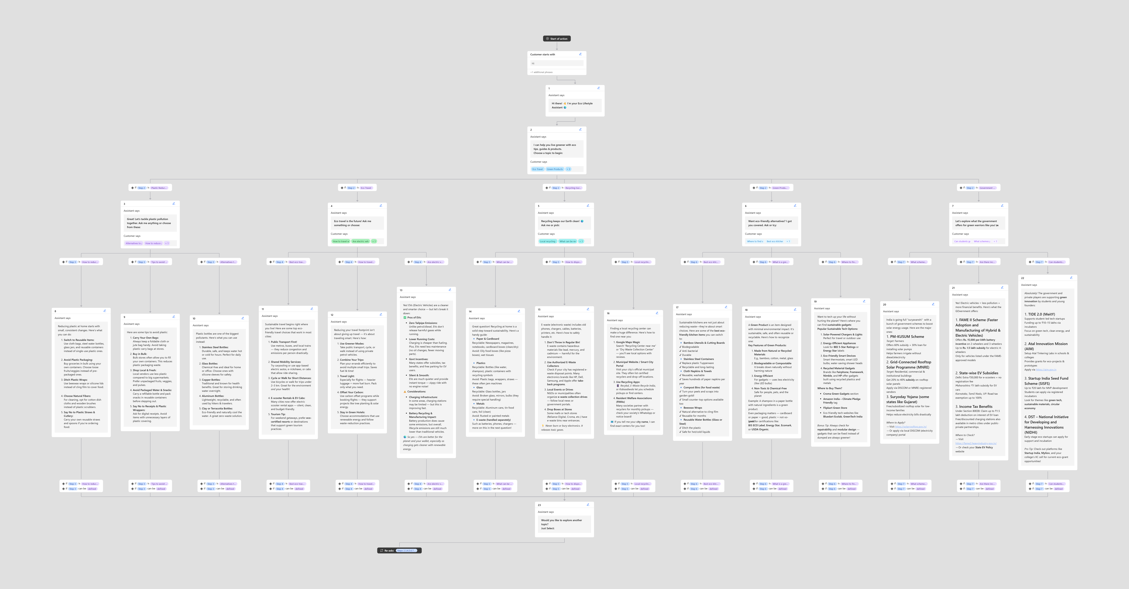
Result

Slide 12
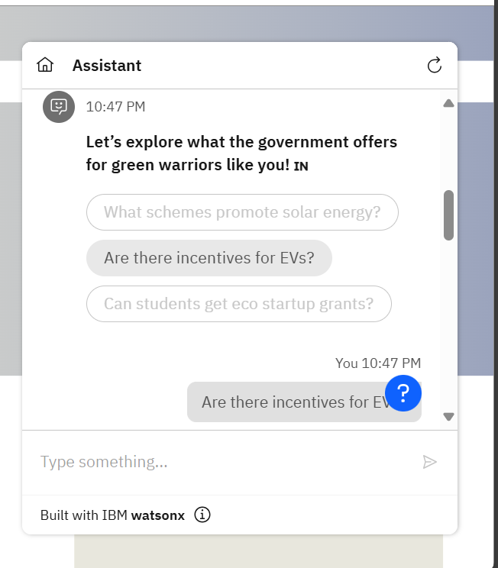
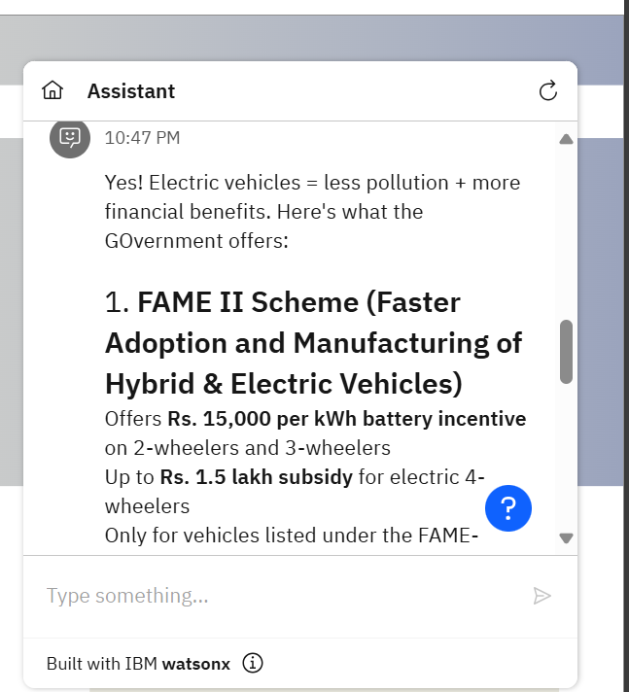
Result

Slide 13
Conclusion
By combining technology with sustainability, this agent helps users make conscious, eco-friendly choices every day. Using Watsonx Assistant, it provides relatable, real-time advice and gamified tips that make green living easier. The platform builds lasting habits with a personal touch, encouraging users to take part in protecting the planet.

Slide 14
Future scope
• The Eco Lifestyle Agent can work with IoT devices to monitor energy and water use in real time.
• Location-based suggestions can help users find local recycling centers, green events, and transport options.
• Gamified rewards and community challenges can increase user engagement and motivation.
• With Watsonx.ai, the agent will learn and adjust to user habits, making sustainability very personalized.

Slide 15
References
ChatGpt- Conceptualized & co-developed with OpenAI ChatGPT for guidance
ChatGPT
UN Environment Programme (UNEP)– Global eco-tips, sustainable lifestyle resources
UNEP
MNRE (Ministry of New and Renewable Energy) – Solar rooftop, EV & green energy schemes MNRE
MoEFCC (India Environment Ministry) – Govt. schemes, recycling rules, plastic bans
MoEFCC
Watson Assistant Documentation – IBM setup, training, and integration help :
IBM Cloud Docs

Slide 16
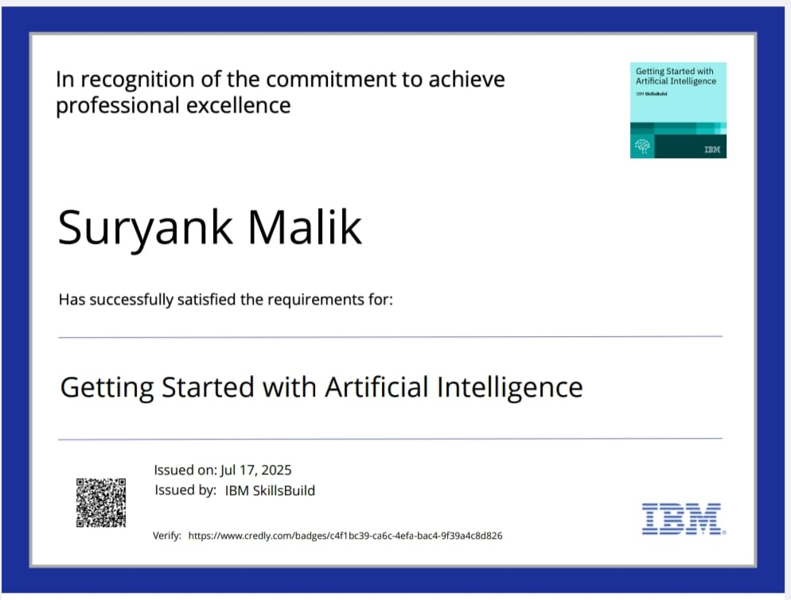
IBM Certifications

Slide 17
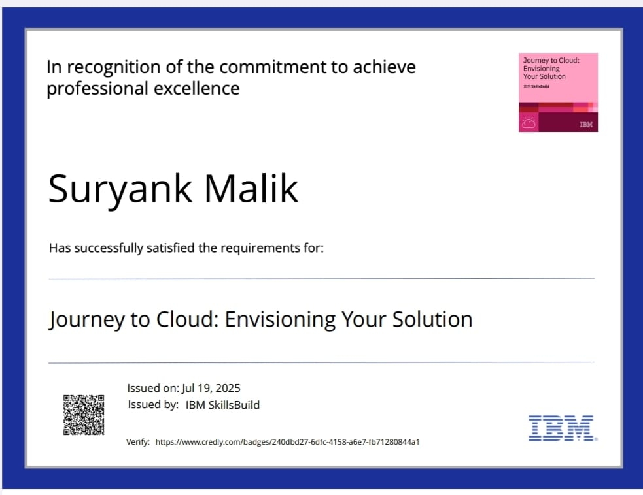
IBM Certifications

Slide 18
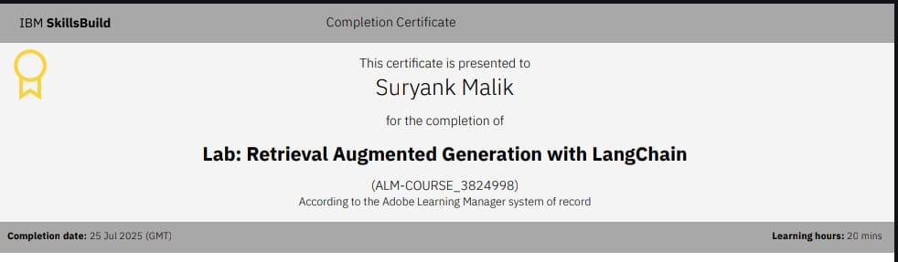
IBM Certifications

Slide 19
Github link- https://github.com/Suryank7/Eco-Lifestyle-Agent

Slide 20
THANK YOU

